Slide 1
Miller Indices
Dr. Ranjit Kumar
Department of Chemical Engineering
Email: ranjit.kumar@snu.edu.in

Slide 2
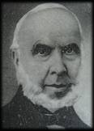
MILLER INDICES
William Hallowes Miller
The set of three integers used to describe the
orientation of a crystal planes are called Miller Indices.
General form for Miller Indices of a plane is (h k l)

Slide 3
Miller indices are used to specify directions and planes.
These directions and planes could be in lattices or in crystals.
(It should be mentioned at the outset that special care should be given to see if the indices are in a lattice or a crystal).
The number of indices will match with the dimension of the lattice or the crystal: in 1D there will be 1 index, in 2D there will be two indices, in 3D there will be 3 indices, etc.
Sometimes, like in the case of Miller-Bravais indices for hexagonal lattices and crystals, additional indices are used to highlight the symmetry of the structure. In the case of the Miller-Bravais indices for hexagonal structures, a third redundant index is added (h k i l)→ 4 indices are used in 3D space. The use of such redundant indices bring out the equivalence of the members of a ‘family’.
Some aspects of Miller indices, especially those for planes, are not intuitively understood and hence some time has to be spent to familiarize oneself with the notation.
Note: both directions and planes are imaginary constructs
Miller Indices
Miller Indices
Directions
Planes
Lattices
Crystals

Slide 4
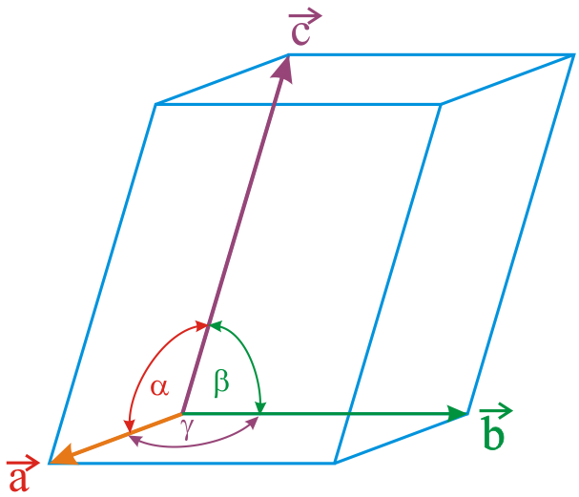
Miller indices for DIRECTIONS
❐ A vector r passing from the origin to a lattice point can be written as: r = r₁ a + r₂ b + r₃ c
❐ Where, a, b, c → basic vectors (or generator vectors).
Basis vectors are unit lattice translation vectors, which define the coordinate axis (as in the figure below).
Note that their lengths are usually one lattice translation and not 1 lengthscale unit! (this is unlike for the basis vectors of a coordinate axis). To give an example, if a rectangle crystal has lattice parameters a = 1 cm and b = 2.5 cm, then |a| = 1 cm and |b| = 2.5 cm (it is not 1 cm along the axes and the scale of the unit along the two directions are different).
In some cases, based on convenience, we may chose the basis vector as ‘multiple lattice translations’ (i.e. instead of one lattice translation we may chose 2 or 3).
We may also chose alternate basis vectors for the same structure (which corresponds to different unit cells).

Slide 5
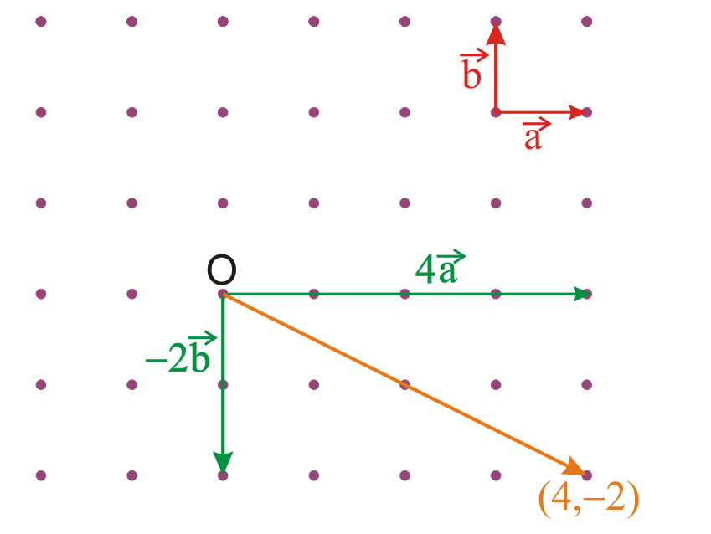
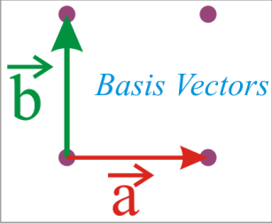
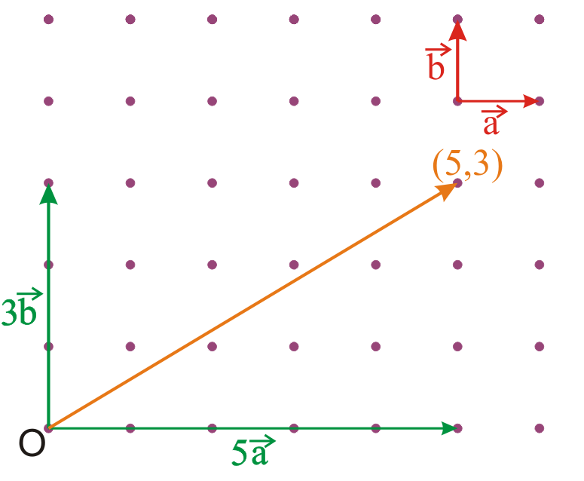
Miller Indices for directions in 2D
Another 2D example
Normally, we ‘take out’ the common factor
Miller indices → [53]
And then omit it!
STEPS in the determination of Miller indices for directions
Position the vector, such that start (S: (x₁, y₁)) and end points (E: (x₂, y₂)) are lattice points and note the value of the coordinates. Subtract to obtain: ((x₂−x₁), (y₂−y₁)).
Write these number in square brackets, without the ‘comma’: [* *].
‘Remove’ the common factors. (Note: keep the common factor, preferably outside the bracket, if the length has to be preserved in further computations).

Slide 6
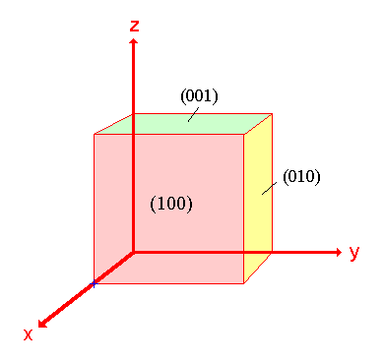
Points, Directions and Planes in the Unit Cell
Miller indices - A shorthand notation to describe certain crystallographic directions and planes in a material. Denoted by <>, ( ), [ ], { } brackets. A negative number is represented by a bar over the number.

Slide 7
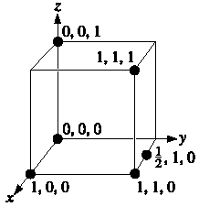
Point Coordinates
Coordinates of selected points in the unit cell.
The number refers to the distance from the origin in terms of lattice parameters.

Slide 8
Point Coordinates
z
111
Point coordinates for unit cell center are
a/2, b/2, c/2 ½ ½ ½
Point coordinates for unit cell corner are 111
Translation: integer multiple of lattice constants → identical position in another unit cell
c
y
a
000
b
x
z
2c
b
y
b

Slide 9
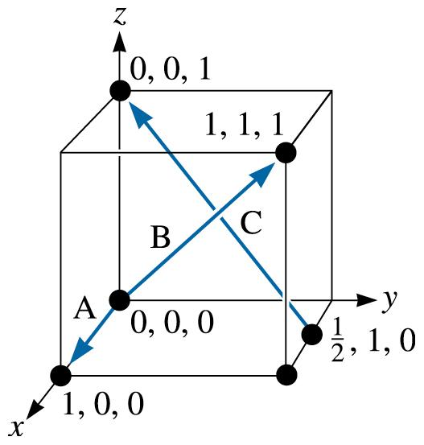
Miller Indices, Directions
Determine the Miller indices of directions A, B, and C.
(c) 2003 Brooks/Cole Publishing / Thomson Learning™

Slide 10
SOLUTION
Direction A
1. Two points are 1, 0, 0, and 0, 0, 0
2. 1, 0, 0, -0, 0, 0 = 1, 0, 0
3. No fractions to clear or integers to reduce
4. [100]
Direction B
1. Two points are 1, 1, 1 and 0, 0, 0
2. 1, 1, 1, -0, 0, 0 = 1, 1, 1
3. No fractions to clear or integers to reduce
4. [111]
Direction C
1. Two points are 0, 0, 1 and 1/2, 1, 0
2. 0, 0, 1 -1/2, 1, 0 = -1/2, -1, 1
3. 2(-1/2, -1, 1) = -1, -2, 2

Slide 11
Crystallographic Directions
z
Algorithm
1. Vector repositioned (if necessary) to pass
through origin. 2. Read off projections in terms of unit cell dimensions a, b, and c 3. Adjust to smallest integer values 4. Enclose in square brackets, no commas
[uvw]
y
x
ex: 1, 0, ½
=> 2, 0, 1
=> [ 201 ]
-1, 1, 1
=>
[ 111 ]
where overbar represents a negative index
Notes:
Lecture 2 ended here

Slide 12
Families of Directions <uvw>
For some crystal structures, several nonparallel directions with different indices are crystallographically equivalent; this means that atom spacing along each direction is the same.

Slide 13
Crystallographic Planes
If the plane passes thru origin, either:
Construct another plane, or
Create a new origin
Then, for each axis, decide whether plane intersects or parallels the axis.
Algorithm for Miller indices
1. Read off intercepts of plane with axes in terms of a, b, c
2. Take reciprocals of intercepts
3. Reduce to smallest integer values
4. Enclose in parentheses, no commas.

Slide 14
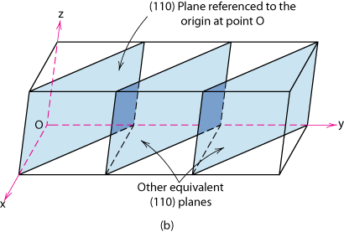
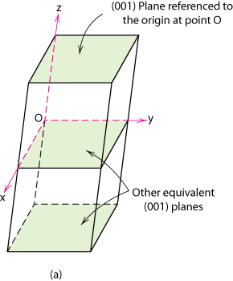
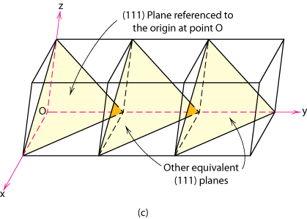
Crystallographic Planes
Crystallographic planes are specified by 3 Miller Indices (h k l). All parallel planes have same Miller indices.

Slide 15
Crystallographic Planes
z
example
a b c
c
1. Intercepts
1 1 ∞
2. Reciprocals
1/1 1/1 1/∞
1 1 0
3. Reduction
1 1 0
y
a
b
4. Miller Indices (110)
x
z
example
a b c
1. Intercepts
1/2 ∞ ∞
c
2. Reciprocals
1/½ 1/∞ 1/∞
2 0 0
3. Reduction
2 0 0
y
4. Miller Indices (200)
a
b
x

Slide 16
Crystallographic Planes
example
a b c
1. Intercepts
1/2 1 3/4
2. Reciprocals
1/½ 1/1 1/¾
2 1 4/3
z
3. Reduction
6 3 4
c
4. Miller Indices (634)
y
a
b
x

Slide 17
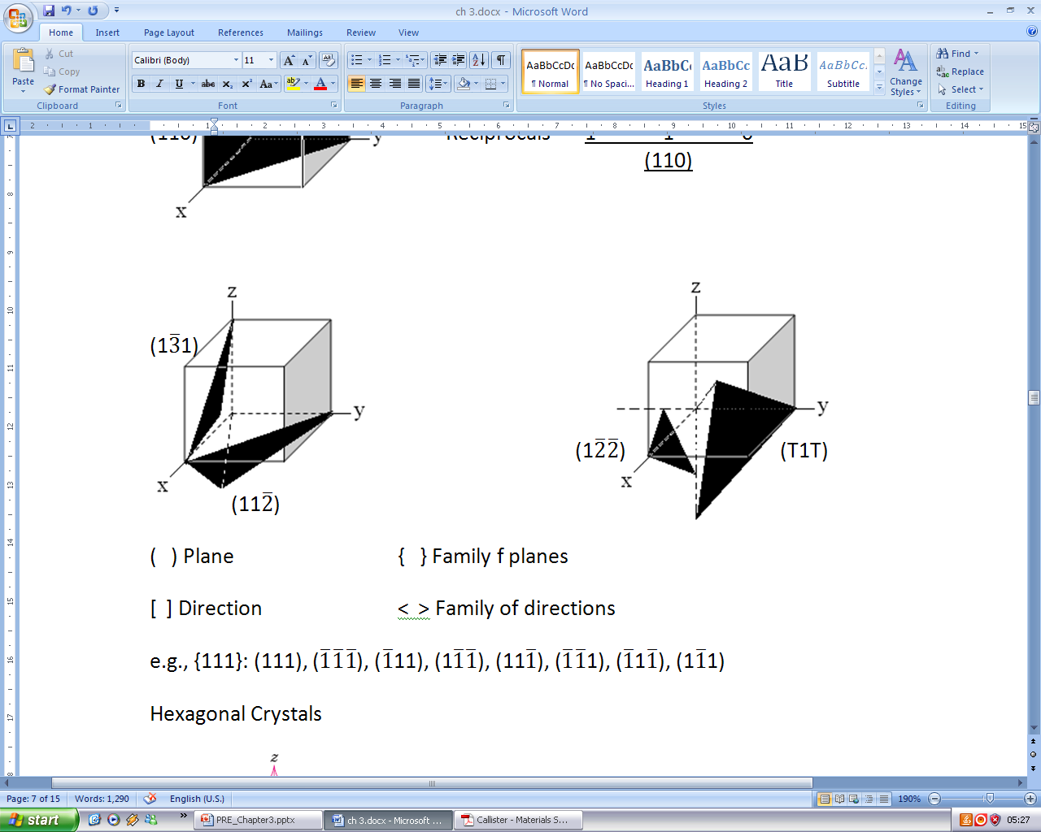
Crystallographic Planes continue.....
Cubic Crystal system

Slide 18
Family of Planes
Planes that are crystallographically equivalent have the same atomic packing.
Also, in cubic systems only, planes having the same indices, regardless of order and sign, are equivalent.
Ex: {111}
= (111), (111), (111), (111), (111), (111), (111), (111)
_
_
_
_
_
_
_
_
_
_
_
_
Ex: {100} = (100),
(010),
(001),
(100),
(010),
(001)

Slide 19
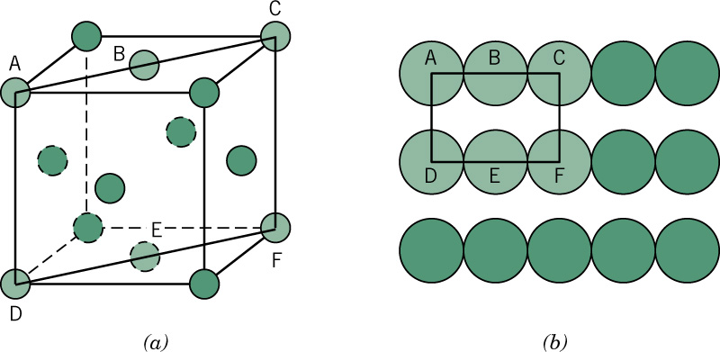
FCC Unit Cell with (110) plane

Slide 20
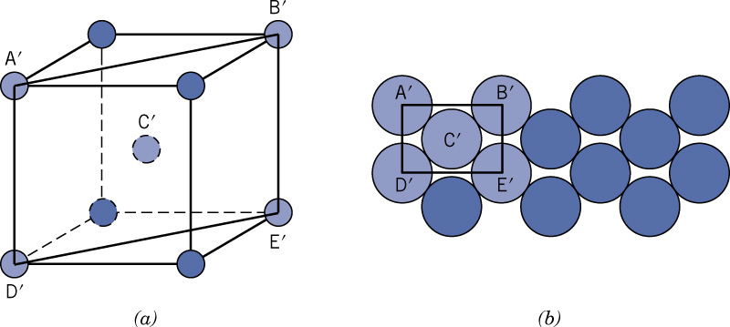
BCC Unit Cell with (110) plane

Slide 21
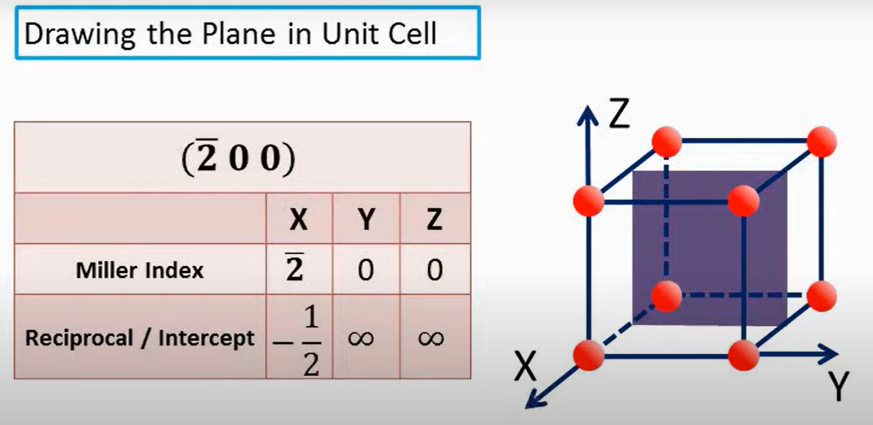

Slide 22
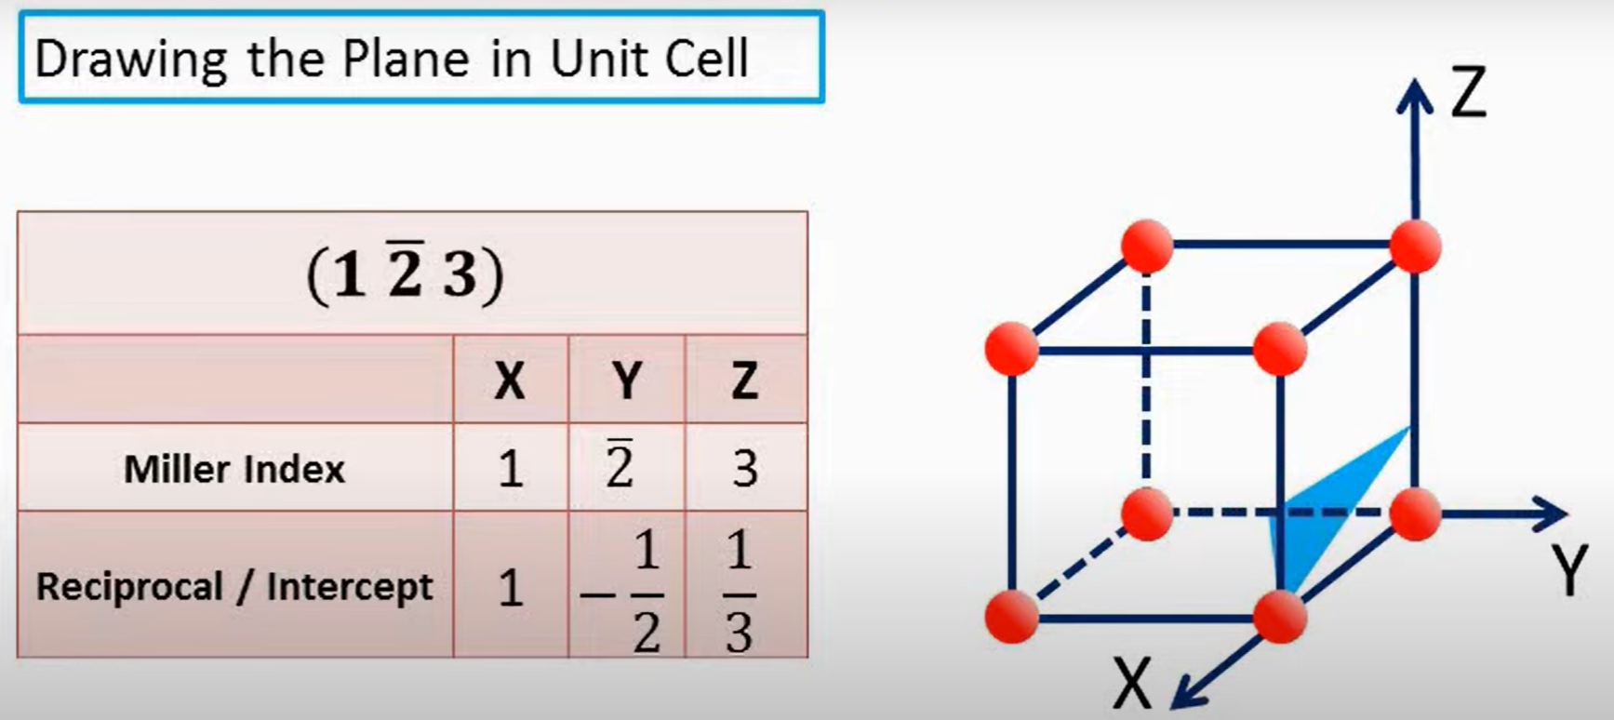

Slide 23
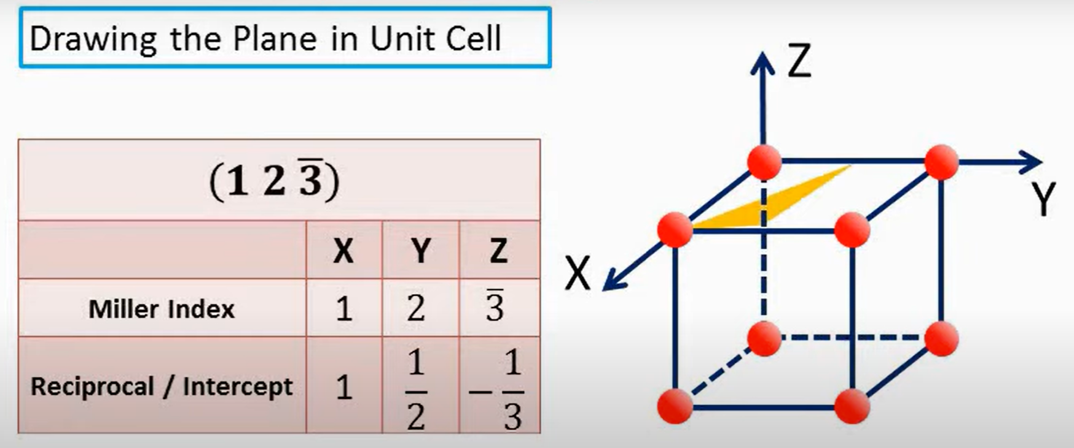

Slide 24
SUMMARY
Crystallographic points, directions and planes are specified in terms of indexing schemes.
Materials can be single crystals or polycrystalline.
Material properties generally vary with single crystal orientation (anisotropic), but are generally non-directional (isotropic) in polycrystals with randomly oriented grains.
Some materials can have more than one crystal structure. This is referred to as polymorphism (or allotropy).

